Slide 1

AWS – the proof!
Lydia Clavina George, Kamil Nowak
15 April 2020
Client confidential
NTT DATA UK
Alistair Donald MacMillan

Slide 2



Roadmap
Again Why AWS?
Under the hood
Our solution
Problems
The Future

Slide 3
Why AWS?

Slide 4
Under The Hood
Goal: Deploy web application that will use database to store data in AWS environment.
Process:
Manual Setup
Tweak
Automate

Slide 5




Under The Hood
What tools/services did we use

Slide 6
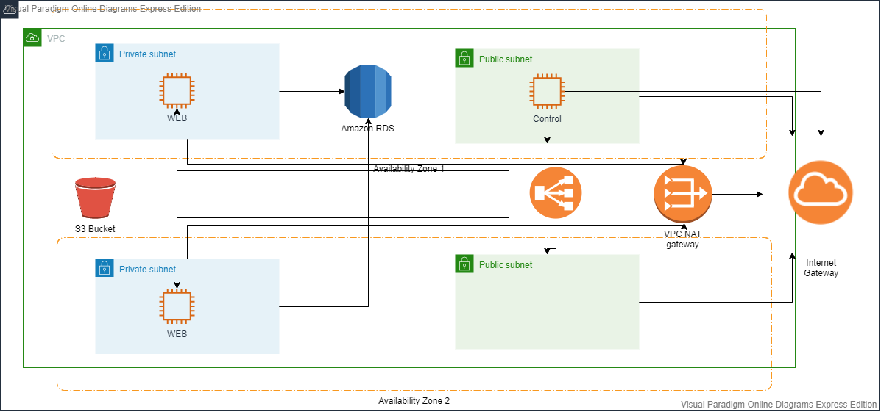
Our Solution - Architecture

Slide 7
Demo

Slide 8
Created EC2 instances for control and web
Assigned both public and private subnets for each instance respectively
Ensuring integrity is achieved by connecting to the web EC2’s through AWS’s available regions
Applied Load balancing features

Slide 9
What issues did we come across?
Deploy war on web server using S3
Roles/Permission issues with IAM and S3 bucket
Time constraints

Slide 10
Future
Higher level of automation
Bastion
Across Regions?
Management Console (Users, instances)
Database Backup – Sync.

Slide 11
Lydia Clavina George, Kamil Nowak
15 April 2020

